Slide 1
QA Final Project
House Chores Flask Project Terms of reference:
To create a web application that integrates with a database and demonstrates CRUD functionality.
To utilise containers to host and deploy your application.
To create a continuous integration (CI)/continuous deployment (CD) pipeline that will automatically test, build and deploy your application.
T
From application import app, db
File "/home/Felicity/webApp2/application/__init__.py", line 12, in <module>
from application import routes
File "/home/Felicity/webApp2/application/routes.py", line 2, in <module>
from application.models import Properties
File "/home/Felicity/webApp2/application/models.py", line 44
Properties_id = db.Column(db.Integer), db.ForeignKey('Properties.id'), nullable=False
Felicity Triner 24th Jan 22 My Terms reference:To create a web application that integrates with a database and demonstrates CRUD functionALITY .
To c

Slide 2
The backbone of DevOps is CI and CD
follows this route:
STARTs
CI and CD means continuous Integration and continuous deployment
DevOps whereby Devlopers and IT operations working collaboratively which continuous Intergration and Deployment

Slide 3
The Project Brief Tools
Git. Python Code, Build. Version Control Collaboration-Python is an Open source And Assessible
Jenkins. Jenkins Pipeline Build, Test, Deploy. Also Github allows for automation of the software workflows and can Build and Test and Deploy code.
Docker. Build, Deploy, Operate.

Slide 4
This slide shows the technologies/Tools Used for House Chores FLASK APP
The Activities & Process (setup)
2 Github repo Kanban
First Created Virtual Machines on Microsoft Azure. Two Virtual machine were made. Development and Production. One machine (Felicity2) was used for the code editor Virtual Studio IDE & Python 3.8 DB VENV and the second machine (Deployment) was used for the Production for the eg Jenkins Docker containers Dockerhub
Created a new Project - Github repository was created git@github.com:Fel65/webApp2.git.
Create a Github Boards-Kanban board and User Stories see slide 6
Code was cloned down from Github using CLI on Visual studio code. Also Visual Studio a Config file was essential for the Azure VMS connection.
Create a Feature branch- feature/1create_chore. First need to pwd into Dev branch
Create schema - Create Virtual ENV on CLI to create Database Export CREATE_SCHEMA = True
Start to use Python 3.9 code to Build webAPP2
AzurePortal
3 Jenkins Automation Pipeline & unit tests
1Azure Portal
VMS x2 Development and Production
4 Docker Build, Deploy, Operate.
Infrastructure Cloud Resources &
CI and CD pipeline diagram

Slide 5
My Activities Creating House Chores FLASK APP
As a Developer work on the application code the IDE (Integrated Development Environment) it is software for making applications so the code editor is Visual studio code using Python Html CSS my Version control is GIT
As a developer my code was already committed to GIT commit so I had to clone it down into my code editor VSC from my GitHub account.
As DEVOPs developer I had to create Virtual Machines (VMs) on Microsoft Azure. Two VM’s were created one to use for Development eg GIT and Python the second VM to use for Production and Deployment side for utilising Docker to create containers for the webApp2 - House Chores App.
As developer I had to ensure that both my Github account and Azure Virtual Machines were linked creating Public SSH keys. Azure VMs were both set in UK south region to ensure there were no communication difficulties. My Development machine was called Felicity2 and Production was called Deployment. VSC Config file was very essential for the connection to the Azure VM. If there is simple error with the name of the VM or password the connection would not operate.
The files cloned down from Github were :- application folder included the following files: init.py, forms.py, models.py and routes.py there was a templates folder included these
files( index.html, and layout.html)
( tests folder included these files (test_unit.py, _init_.py), gitignore, app.py, README.md, requirements.txt. The app.py is the important file for executing the webApp2. There were difficulties! Output errors :- app.py not detected, not found? Undertook debugging Python code through PDB .I collaborated with a few members of my cohort to try to resolve the the issue but the webApp2 kept failing. Output error app I was going to proceed but I did not want to push bad code to my feature branch because there might be a chance of it being integrated into the . I did manage to find alternative Python Flask code for my webApp2
Jenkins/Azure Pipelines automation kicks off a build based on the Git commit. I was unable to do this get this part of the job because of difficulties with the code bugs delaying progress but the major problem was losing access my Azure Account.
The following steps were not achieved:The Build pipeline pulls the latest ML model from blob storage and creates a container.
The pipeline pushes the build image to the private image repository in ACR.
The Release pipeline kicks off based on the successful build.
The pipeline pulls the latest image from ACR and deploys it across the Kubernetes /Docker Swarm cluster on AKS.
User requests for the app go through the DNS server.
The DNS server passes the requests to a load balancer, and sends responses back to the users.
Notes:
The following steps were not achieved:The Build pipeline pulls the latest ML model from blob storage and creates a container.
The pipeline pushes the build image to the private image repository in ACR.
The Release pipeline kicks off based on the successful build.
The pipeline pulls the latest image from ACR and deploys it across the Kubernetes /Docker Swarm cluster on AKS.
User requests for the app go through the DNS server.
The DNS server passes the requests to a load balancer, and sends responses back to the users.

Slide 6
The steps below would have been undertaken if it had not been for the code bugs and Azure Portal being blocked
The Build pipeline pulls the latest ML model from blob storage and creates a container.
The pipeline pushes the build image to the private image repository in ACR.
The Release pipeline kicks off based on the successful build.
The pipeline pulls the latest image from ACR and deploys it across the Kubernetes /Docker Swarm cluster on AKS.
User requests for the app go through the DNS server.
The DNS server passes the requests to a load balancer, and sends responses back to the users.

Slide 7
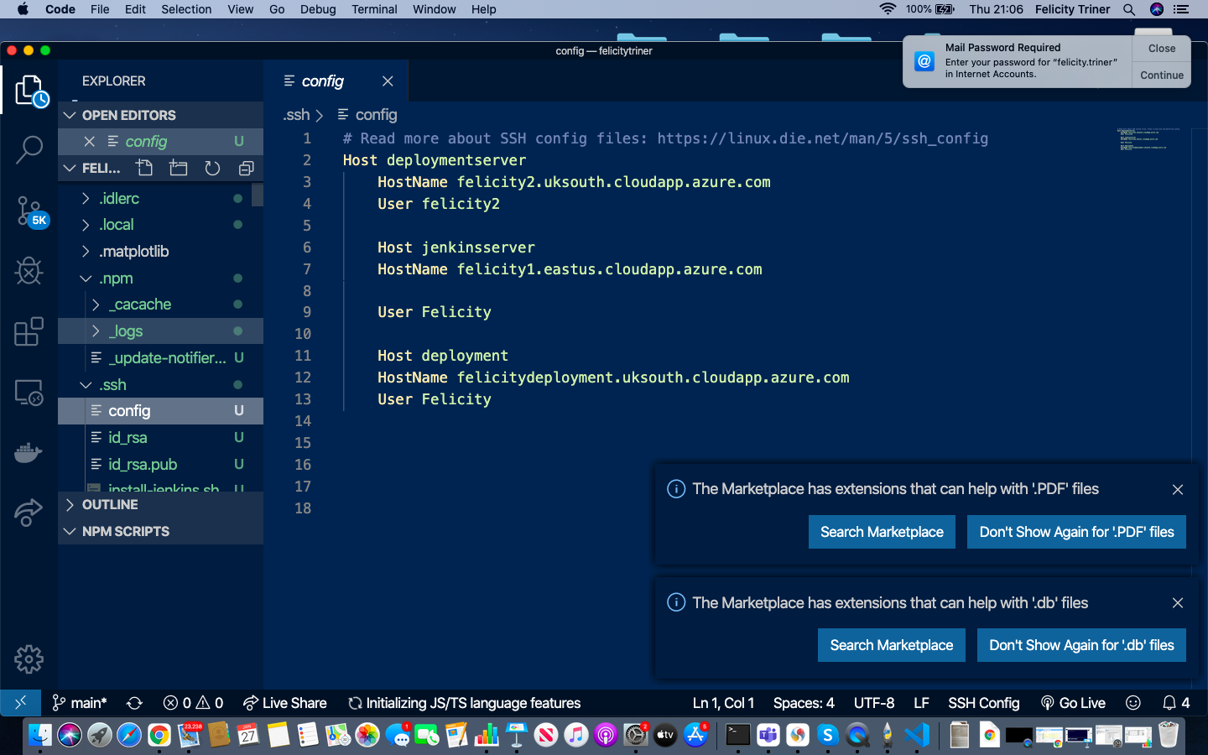
CONFIG File
CONFIG File important for the connection to the Azure VM.

Slide 8
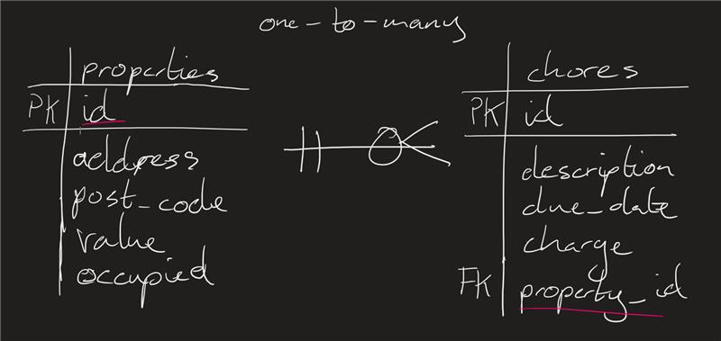
Entity Relationship
Diagram
Model one to many relationship using Sqlalchemy.
The DB chores table has CRUD functionality
House Chores APP
M
O
S
C
O
W
Email
Completed
Worker
Felicity Triner MOsCOW has Also been shown on ERD diagram

Slide 9
CRUD Functionality
House Chores Flask App
C reate = Able to create new House chores and create details of properties
R ead= Able to read and edit details of the chores and details of properties in case chores change
U pdate= Able to see whether House chores have been completed and whether properties need house chores undertaken and amend.
D elete= Able to delete house chores that are no longer needed anymore and properties no longer needing House chores
This information was incorporated in the Github Board (kanban board) as user stories. See next slide
Felicity Triner 24th Jan

Slide 10
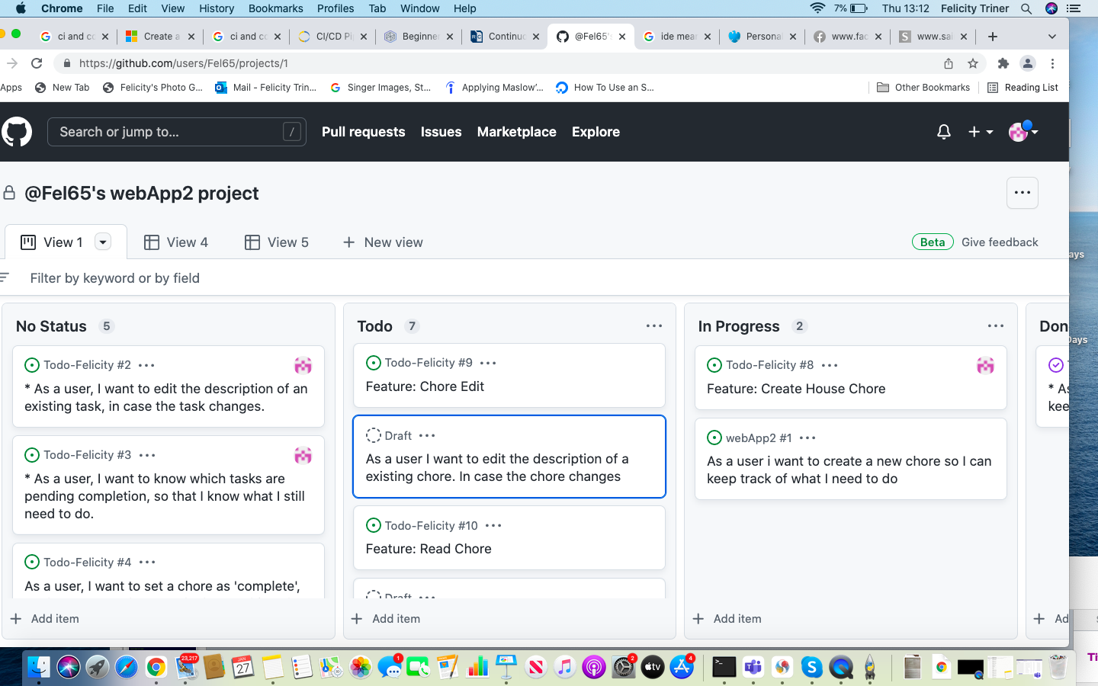
Github Board - user stories

Slide 11
Evaluation Risk Assessment
Syntax errors 31st Dec 2021
What went wrong | Issues | Contigency Plans | What went right | What I have learnt
Essential that the files are cloned down from Github correctly | Not all files were cloned properly- missing code. | Use alternative code | I was able to clone some of the files. Used the debugger to correct code | To have alternative code ready Take regular backups. Need ensure code is not broken or incomplete!
VM for SQL server went down | Target missed to undertake automation and code was not recoverable | Did save it to the Github VCS | I was able to create DB file | Resolve account issues with Microsoft early!
VM for Jenkins server went down | Target missed to undertake automation and code was not recoverable | Did not get to the stage to save it Github VCS. However some of the files | I was able to install Jenkins on VM
Sharing of secret credentials by pushing to Github, for example the credentials for SQL machine and database | None | If you use os.getenv The Jenkins credentials secrets, and password these would be protected | This was achievable | Different ways to create a database eg using inbuilt Sqlite but ensuring no sensitive info is pushed up to the VCS
Azure Account issues lost use of Vm ‘s | Locked out of the account and could use VM’s | Make funds available to have had my own account | This is still in progress contacted Microsoft re: Azure account. Will be resolving the issue | Things are not a simple fix. Perhaps if I had an expert give guidance on options on how to proceedNot sure why VSC did not save code?
Macbook Computer screen cracked | Difficult to use machine and machine is now only | Use of another computer
Pandemic Covid - Son and Husband got Covid | Caring responsibilities delay on completing work | Not sure how this could could have been prevented

Slide 12
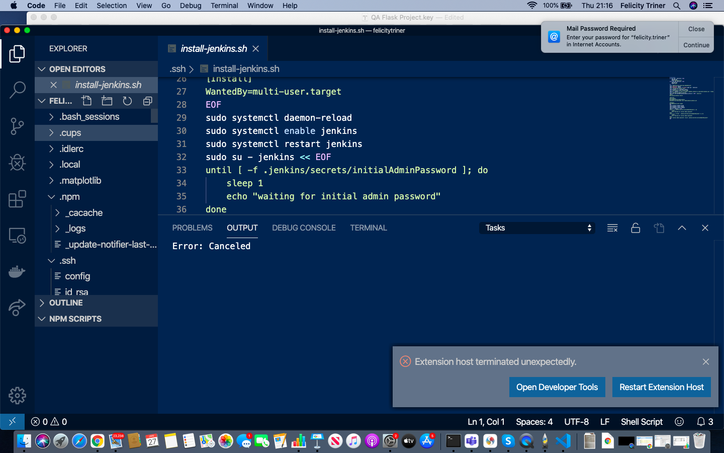
Jenkins Installation

Slide 13
Alternative ERD Felicity Tracking Views Website
Felicity Song viewed
PK ID
Foreign Key( FK) | Fan ID
 | Song Description
 | Date
 | Review
FAN
PK ID
email address
Country
M O S C O W
Notes:
This will be a new Flask Python App if I cannot recover the Python files from my VM from Azure Account. Python Code would need to be reworked and adapted.

